Slide 1
INTRODUCTION TO OMICS DATA ANALYSIS RNA-seq
Bioinformatics Course UEB-VHIR June, 2022
Esther Camacho¹, Mireia Ferrer¹, Álex Sánchez^{1,2}, Angel Blanco^{1,2}, Berta Miró¹ ¹ Unitat d’Estadística i Bioinformàtica (UEB) VHIR ² Departament de Genètica Microbiologia i Estadística, UB

Slide 2
Introduction to omics data analysis
An example of omics data analysis. RNA-seq
What is RNA-seq
Basic key concepts
Main challenges in RNA-seq
RNA-seq vs Microarrays
RNA-seq analysis pipeline(s)
Alignment
Transcript assembly
DEG Analysis
Visualization

Slide 3
Introduction to omics data analysis
An example of omics data analysis. RNA-seq
What is RNA-seq
Basic key concepts
Main challenges in RNA-seq
RNA-seq vs Microarrays
RNA-seq analysis pipeline(s)
Alignment
Transcript assembly
DEG Analysis
Visualization

Slide 4
Introduction to omic data analysis
BIOLOGICAL QUESTION
EXPERIMENTAL DESIGN
OMICS EXPERIMENT
QUALITY CONTROL
NORMALIZATION
ANALYSIS
FILTERING
ESTIMATION
TESTING
CLUSTERING
BIOLOGICAL VERIFICATION AND INTERPRETATION

Slide 5
Introduction to omic data analysis
BIOLOGICAL QUESTION
WET LAB
EXPERIMENTAL DESIGN
OMICS EXPERIMENT
QUALITY CONTROL
NORMALIZATION
ANALYSIS
FILTERING
ESTIMATION
TESTING
CLUSTERING
BIOLOGICAL VERIFICATION AND INTERPRETATION

Slide 6
Introduction to omic data analysis
BIOLOGICAL QUESTION
WET LAB
EXPERIMENTAL DESIGN
OMICS EXPERIMENT
QUALITY CONTROL
NORMALIZATION
DRY LAB
ANALYSIS
FILTERING
ESTIMATION
TESTING
CLUSTERING
BIOLOGICAL VERIFICATION AND INTERPRETATION

Slide 7
Introduction to omics data analysis
An example of omics data analysis. RNA-seq
What is RNA-seq
Basic key concepts
Main challenges in RNA-seq
RNA-seq vs Microarrays
RNA-seq analysis pipeline(s)
Alignment
Transcript assembly
DEG Analysis
Visualization

Slide 8
2.1 What is RNA-seq?
Sequencing technique of NGS.
It reveals the presence and quantity of RNA in a sample.
It lets to the determination/analysis of the transcriptome.
This sample is sequenced in a particular moment, so the transcriptome obtained is limited to this precise moment.
RNA-Seq
Notes:
RNA-Seq (named as an abbreviation of RNA sequencing) is a sequencing technique which uses next-generation sequencing (NGS) to reveal the presence and quantity of RNA in a biological sample at a given moment, analyzing the continuously changing cellular transcriptome.^{[2][3]}
Specifically, RNA-Seq facilitates the ability to look at alternative gene spliced transcripts, post-transcriptional modifications, gene fusion, mutations/SNPs and changes in gene expression over time, or differences in gene expression in different groups or treatments.^{[4]} In addition to mRNA transcripts, RNA-Seq can look at different populations of RNA to include total RNA, small RNA, such as miRNA, tRNA, and ribosomal profiling.

Slide 9
2.1 What is RNA-seq?
Sequencing technique of NGS.
It reveals the presence and quantity of RNA in a sample.
It lets to the determination/analysis of the transcriptome.
This sample is sequenced in a particular moment, so the transcriptome obtained is limited to this precise moment.
RNA-Seq
RNA-seq enables the finding of:
Alternative gene spliced transcripts,
Post-transcriptional modifications,
Gene fusion,
Mutations/SNPs,
Changes in gene expression
Notes:
RNA-Seq (named as an abbreviation of RNA sequencing) is a sequencing technique which uses next-generation sequencing (NGS) to reveal the presence and quantity of RNA in a biological sample at a given moment, analyzing the continuously changing cellular transcriptome.^{[2][3]}
Specifically, RNA-Seq facilitates the ability to look at alternative gene spliced transcripts, post-transcriptional modifications, gene fusion, mutations/SNPs and changes in gene expression over time, or differences in gene expression in different groups or treatments.^{[4]} In addition to mRNA transcripts, RNA-Seq can look at different populations of RNA to include total RNA, small RNA, such as miRNA, tRNA, and ribosomal profiling.

Slide 10
2.1 What is RNA-seq?
Functional studies
Genome may be constant but an experimental condition has a pronounced effect on gene expression
e.g. Drug treated vs. untreated cell line
e.g. Wild type versus knock out mice
Some molecular features can only be observed at the RNA level
Alternative isoforms, fusion transcripts, RNA editing
Predicting transcript sequence from genome sequence is difficult
Alternative splicing, RNA editing, etc.

Slide 11
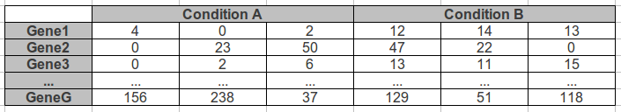
2.1 What is RNA-seq?
RNA-seq is the high throughput sequencing of cDNA using NGS technologies
RNA-seq works by sequencing every RNA molecule and profiling the expression of a particular gene by counting the number of time its transcripts have been sequenced.
The summarized RNA-seq data is widely known as count table

Slide 12
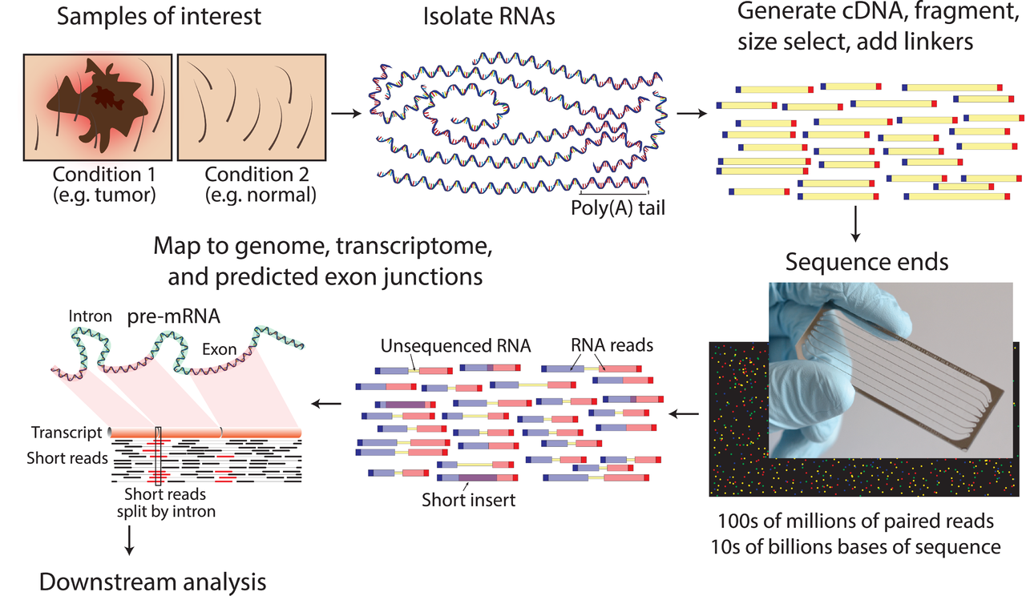
2.1 What is RNA-seq?
RNA-seq (SGS)
https://en.wikipedia.org/wiki/RNA-Seq
Notes:
RNA-Seq (named as an abbreviation of RNA sequencing) is a sequencing technique which uses next-generation sequencing (NGS) to reveal the presence and quantity of RNA in a biological sample at a given moment, analyzing the continuously changing cellular transcriptome.^{[2][3]}
Specifically, RNA-Seq facilitates the ability to look at alternative gene spliced transcripts, post-transcriptional modifications, gene fusion, mutations/SNPs and changes in gene expression over time, or differences in gene expression in different groups or treatments.^{[4]} In addition to mRNA transcripts, RNA-Seq can look at different populations of RNA to include total RNA, small RNA, such as miRNA, tRNA, and ribosomal profiling.

Slide 13
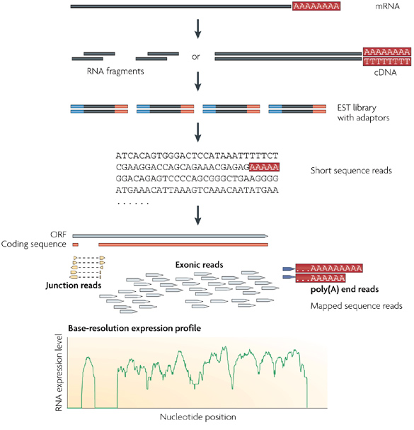
2.1 What is RNA-seq?
Long RNAs are first converted into a library of cDNA fragments through either RNA fragmentation or DNA fragmentation.
Sequencing adaptors (blue) are added to each cDNA fragment and a short sequence is obtained from each cDNA using high-throughput sequencing technology.
The resulting sequence reads are aligned with the reference genome or transcriptome, and classified as three types: exonic reads, junction reads and poly(A) end-reads. These three types are used to generate a base-resolution expression profile for each gene, as illustrated at the bottom; a yeast ORF with one intron is shown.
Nature Reviews Genetics 10, 57-63 (January 2009)

Slide 14
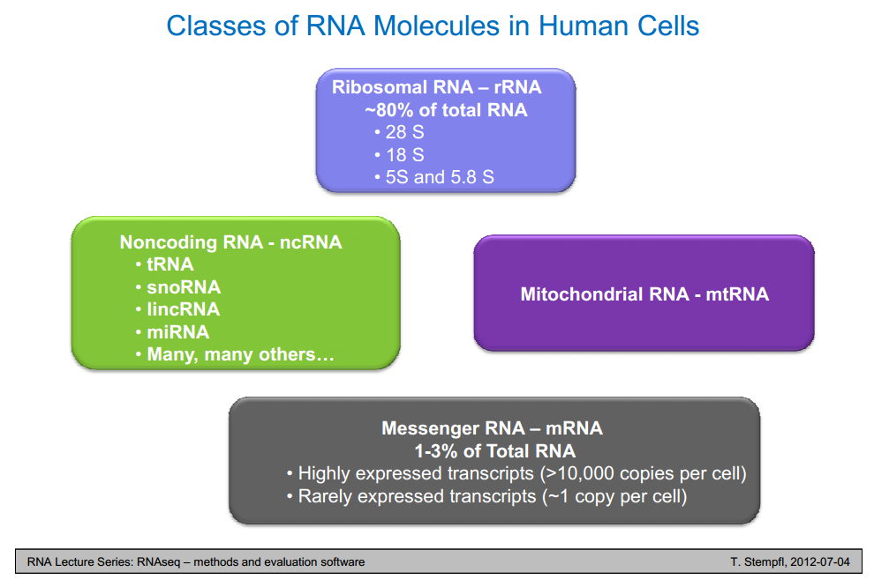
2.1 What is RNA-seq?

Slide 15
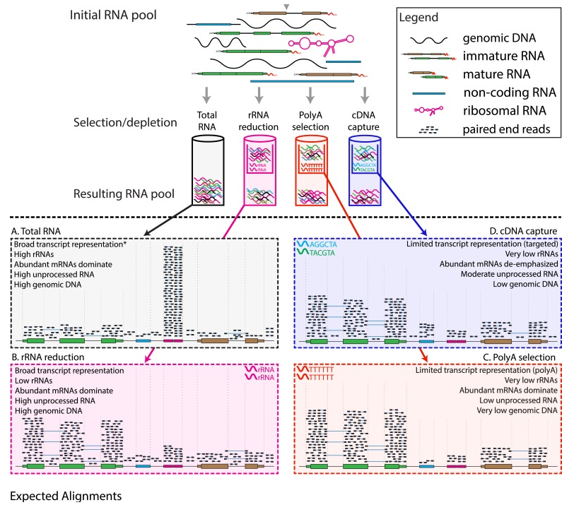
3.3 Main challenges in RNA-seq

Slide 16
Introduction to omics data analysis
An example of omics data analysis. RNA-seq
What is RNA-seq
Basic key concepts
Main challenges in RNA-seq
RNA-seq vs Microarrays
RNA-seq analysis pipeline(s)
Alignment
Transcript assembly
DEG Analysis
Vizualization

Slide 17
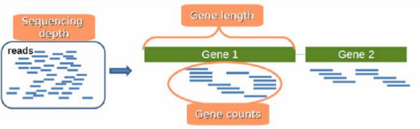
2.2 Basic key concepts?
Sequencing depth: Total number of reads mapped to the genome. (Library size) Could also be applied to samples.
Coverage: Number of reads mapped to a specific region (average of them if we are talking about the whole genome...)
Gene length: Number of bases that a gene has.
Gene counts: Number of reads mapping to that gene (expression measurement)
Local coverage

Slide 18
Introduction to omics data analysis
An example of omics data analysis. RNA-seq
What is RNA-seq
Basic key concepts
Main challenges in RNA-seq
RNA-seq vs Microarrays
RNA-seq analysis pipeline(s)
Alignment
Transcript assembly
DEG Analysis
Vizualization

Slide 19
3.3 Main challenges in RNA-seq
Sample
Purity? Quantity? Quality?
RNAs consist of small exons that may be separated by large introns
Mapping reads to genome is challenging
Non-uniformity coverage of the genome

Slide 20
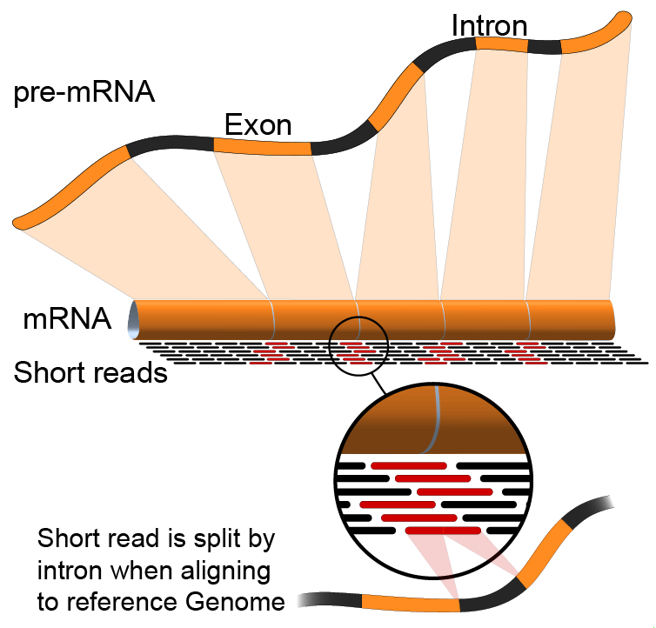
3.3 Main challenges in RNA-seq
Sample
Purity? Quantity? Quality?
RNAs consist of small exons that may be separated by large introns
Mapping reads to genome is challenging
Non-uniformity coverage of the genome
RNA-Seq
second generation
sequencing

Slide 21
3.3 Main challenges in RNA-seq
Sample
Purity? Quantity? Quality?
RNAs consist of small exons that may be separated by large introns
Mapping reads to genome is challenging
Non-uniformity coverage of the genome
RNA-Seq
third generation
sequencing
Long read
Molecule = Read = Transcript

Slide 22
3.3 Main challenges in RNA-seq
Sample
Purity? Quantity? Quality?
RNAs consist of small exons that may be separated by large introns
Mapping reads to genome is challenging
Non-uniformity coverage of the genome
The relative abundance of RNAs vary wildly
10⁵ – 10⁷ orders of magnitude
Since RNA sequencing works by random sampling, a small fraction of highly expressed genes may consume the majority of reads (rRNA)
RNAs come in a wide range of sizes
Small RNAs must be captured separately
PolyA selection of large RNAs may result in 3’ end bias
RNA is fragile compared to DNA (easily degraded)
Library preparation

Slide 23
3.3 Main challenges in RNA-seq
Capture of less abundant RNAs
Avoid the conversion to cDNA prior to library construction
RNA-Seq TGS Increasing the yield
Avoid degradation at 5’ end

Slide 24
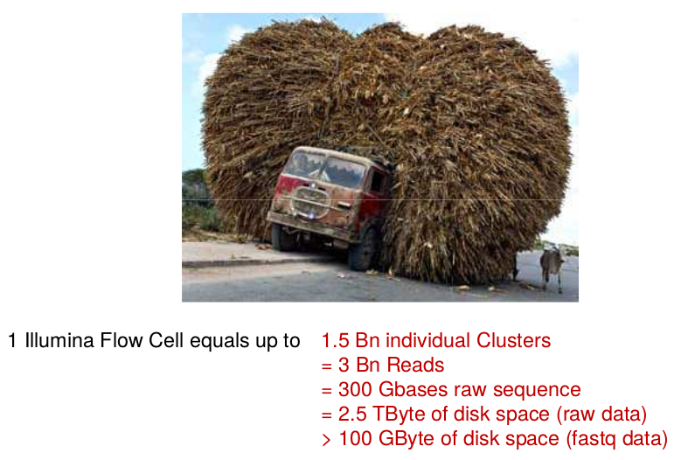

3.3 Main challenges in RNA-seq
Independently of the software used, one needs to think about
DATA STORAGE & MANAGEMENT!!

Slide 25
Introduction to omics data analysis
An example of omics data analysis. RNA-seq
What is RNA-seq
Basic key concepts
Main challenges in RNA-seq
RNA-seq vs Microarrays
RNA-seq analysis pipeline(s)
Alignment
Transcript assembly
DEG Analysis
Vizualization

Slide 26
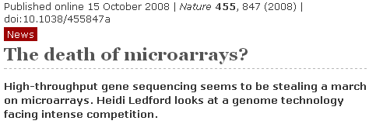


2.4 RNA-seq vs Microarrays
reproducibility
only show you what you’re looking for
what about ‘indels’, inversions, translocations...
accuracy
sensitivity

Slide 27
2.4 RNA-seq vs Microarrays
Abstract
RNAseq and microarray methods are frequently used to measure gene expression level. While similar in purpose, there are fundamental differences between the two technologies. Here, we present the largest comparative study between microarray and RNAseq methods to date using The Cancer Genome Atlas (TCGA) data. We found high correlations between expression data obtained from the Affymetrix one-channel microarray and RNAseq (Spearman correlations coefficients of ∼0.8). We also observed that the low abundance genes had poorer correlations between microarray and RNAseq data than high abundance genes. As expected, due to measurement and normalization differences, Agilent two-channel microarray and RNAseq data were poorly correlated (Spearman correlations coefficients of only ∼0.2). By examining the differentially expressed genes between tumor and normal samples we observed reasonable concordance in directionality between Agilent two-channel microarray and RNAseq data, although a small group of genes were found to have expression changes reported in opposite directions using these two technologies. Overall, RNAseq produces comparable results to microarray technologies in term of expression profiling. The RNAseq normalization methods RPKM and RSEM produce similar results on the gene level and reasonably concordant results on the exon level. Longer exons tended to have better concordance between the two normalization methods than shorter exons.

Slide 28
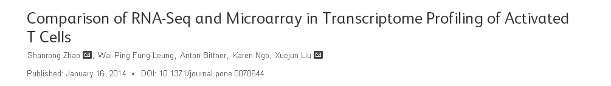
2.4 RNA-seq vs Microarrays
RNA-Seq was superior in detecting low abundance transcripts
also better detecting differentiating biologically isoforms
RNA-Seq demonstrated a broader dynamic range than microarray.
RNA-Seq avoid problems inherent to microarray probe performance
!!!The study try to demonstrate the benefits of RNA-Seq over microarray in transcriptome profiling

Slide 29
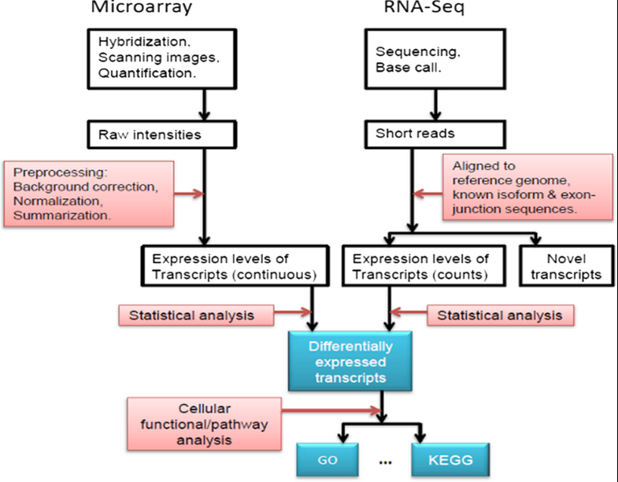
2.4 RNA-seq vs Microarrays

Slide 30
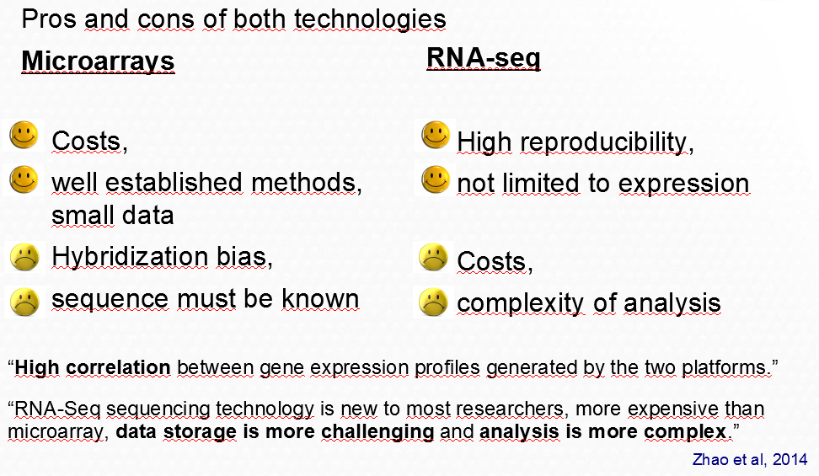
2.4 RNA-seq vs Microarrays

Slide 31
Introduction to omics data analysis
An example of omics data analysis. RNA-seq
What is RNA-seq
Basic key concepts
Main challenges in RNA-seq
RNA-seq vs Microarrays
RNA-seq analysis pipeline(s)
Alignment
Transcript assembly
DEG Analysis
Vizualization

Slide 32
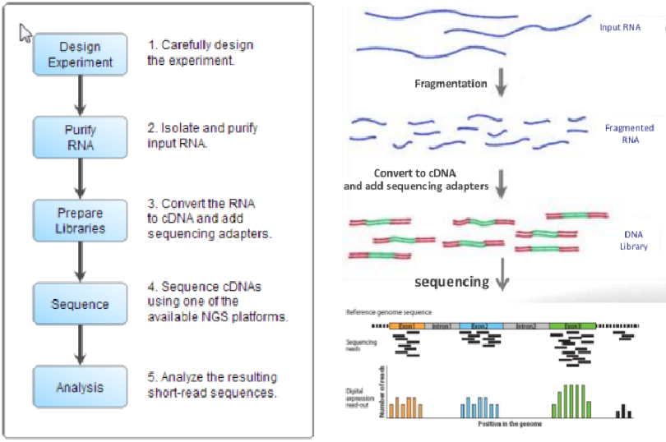
2.5 RNA-seq analysis pipeline(s)

Slide 33
2.5 RNA-seq analysis pipeline(s)

Slide 34
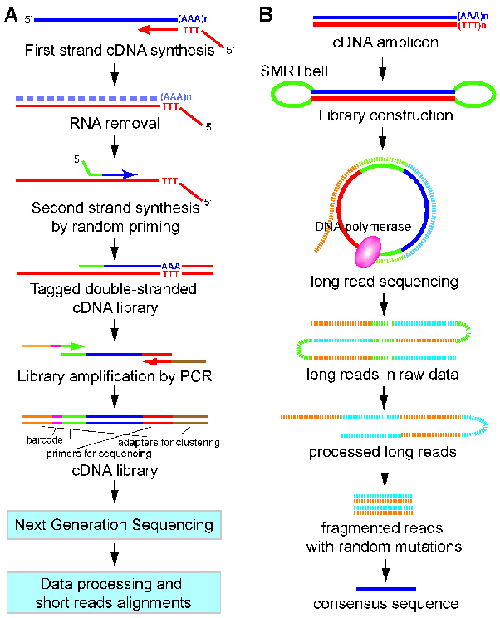

2.5 RNA-seq analysis pipeline(s)
RNA-Seq workflow
A= RNA-Seq (SGS)
B= RNA-Seq (TGS) -> Iso-Seq (PacBio)
https://pubmed.ncbi.nlm.nih.gov/28148393/
Analysis

Slide 35
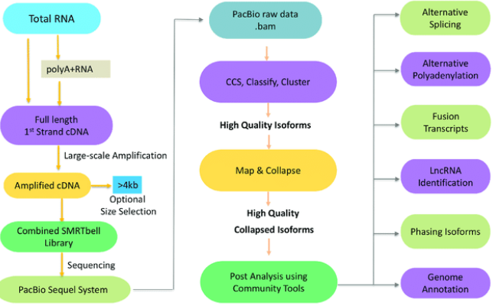
2.5 RNA-seq analysis pipeline(s)
RNA-Seq (TGS) pipeline exemple: Iso-Seq
https://www.frontiersin.org/articles/10.3389/fgene.2019.00384/full

Slide 36

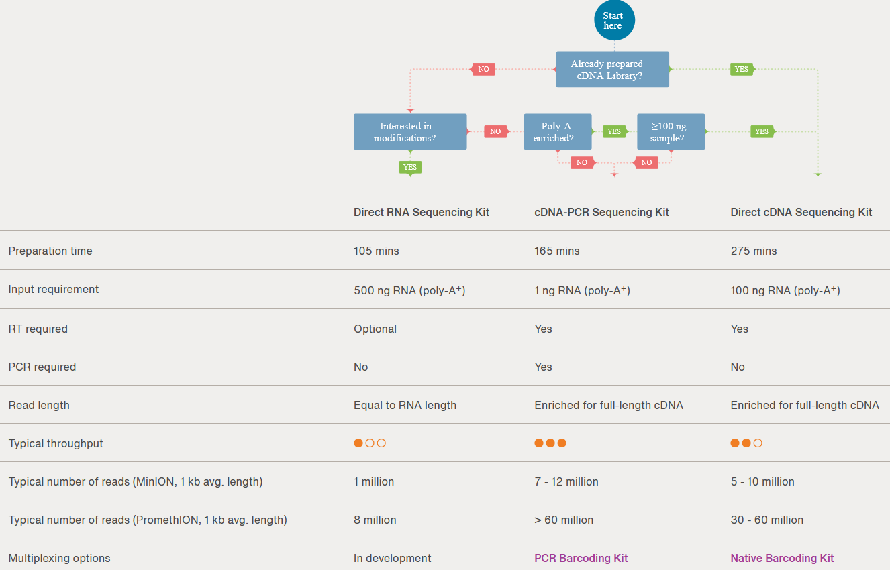
2.5 RNA-seq analysis pipeline(s)
RNA-Seq (TGS) : Oxford nanopore (ONT)
Tenen 3 kits!
https://nanoporetech.com/applications/rna-sequencing

Slide 37
2.5 RNA-seq analysis pipeline(s)
RNA-Seq (TGS) : Oxford nanopore (ONT)
Tenen 3 kits!
https://nanoporetech.com/applications/rna-sequencing

Slide 38
2.5 RNA-seq analysis pipeline(s)
RNA-Seq (SGS)
Steps Standard pipeline

Slide 39
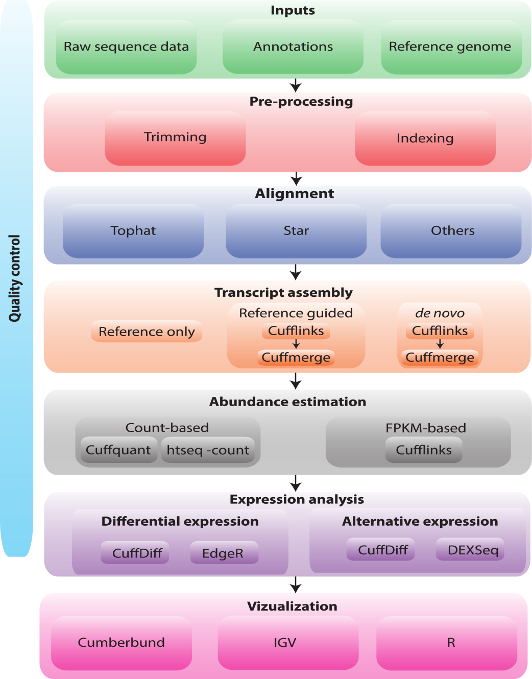
2.5 RNA-seq analysis pipeline(s)
RNA-Seq (SGS)
Griffith, 2015 DOI: 10.1371/journal.pcbi.1004393

Slide 40
2.5 RNA-seq analysis pipeline(s)
Fastq files
FASTQC (quality control)
Griffith, 2015 DOI: 10.1371/journal.pcbi.1004393

Slide 41
2.5 RNA-seq analysis pipeline(s)
Fastq files
FASTQC (quality control)
Griffith, 2015 DOI: 10.1371/journal.pcbi.1004393

Slide 42
2.5 RNA-seq analysis pipeline(s)
Griffith, 2015 DOI: 10.1371/journal.pcbi.1004393

Slide 43
2.5 RNA-seq analysis pipeline(s)
Cutadapt
Trimmomatic
...
Griffith, 2015 DOI: 10.1371/journal.pcbi.1004393

Slide 44
2.5 RNA-seq analysis pipeline(s)
Griffith, 2015 DOI: 10.1371/journal.pcbi.1004393

Slide 45
Introduction to omics data analysis
An example of omics data analysis. RNA-seq
What is RNA-seq
Basic key concepts
Main challenges in RNA-seq
RNA-seq vs Microarrays
RNA-seq analysis pipeline(s)
Alignment
Transcript assembly
DEG Analysis
Vizualization

Slide 46
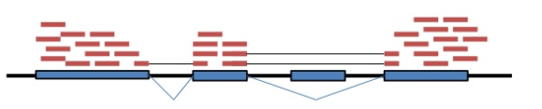
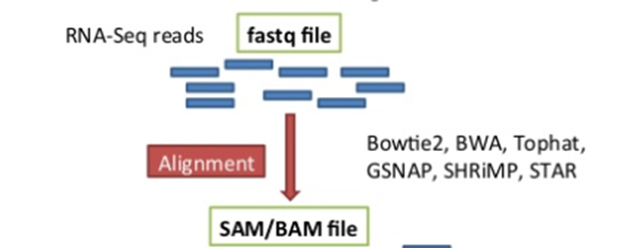
2.6 Alignment
What to map to?
Map to the genome, with knowledge of transcript annotations
• Well annotated genome reference is required.
• To eﬀectively map to exon junctions, you need a mapping algorithm that can divide the sequencing reads and map portions independently.
• Identifying alternative transcript isoforms involves complex algorithms

Slide 47
2.6 Alignment
Which sequence mappers to use?
• RNASeq Alignment algorithm must be
Fast
Able to handle SNPs, indels, and sequencing errors
Maintain accurate quantiﬁcation
Allow for introns for reference genome alignment (spliced alignment detection)

Slide 48
2.6 Alignment
Which sequence mappers to use?
• RNASeq Alignment algorithm must be
Fast
Able to handle SNPs, indels, and sequencing errors
Maintain accurate quantiﬁcation
Allow for introns for reference genome alignment (spliced alignment detection)
• Burrows-Wheeler Transform (BWT) mappers
Fast
Limited mismatches allowed (<3)
Limited indel detection ability
Examples: Bowtie2, BWA, Tophat, HISAT2
Use cases: large and conserved genome and transcriptomes
• Hash Table mappers
Require large amount of RAM for indexing
More mismatches allowed
Indel detecIon
Examples: GSNAP, SHRiMP, STAR
Use case: highly variable or smaller genomes, transcriptomes

Slide 49
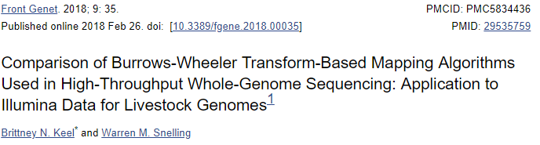
2.6 Alignment
Which sequence mappers to use?
• RNASeq Alignment algorithm must be
Fast
Able to handle SNPs, indels, and sequencing errors
Maintain accurate quantiﬁcation
Allow for introns for reference genome alignment (spliced alignment detection)
• Burrows-Wheeler Transform (BWT) mappers
Fast
Limited mismatches allowed (<3)
Limited indel detection ability
Examples: Bowtie2, BWA, Tophat, HISAT2
Use cases: large and conserved genome and transcriptomes
• Hash Table mappers
Require large amount of RAM for indexing
More mismatches allowed
Indel detecIon
Examples: GSNAP, SHRiMP, STAR
Use case: highly variable or smaller genomes, transcriptomes

Slide 50
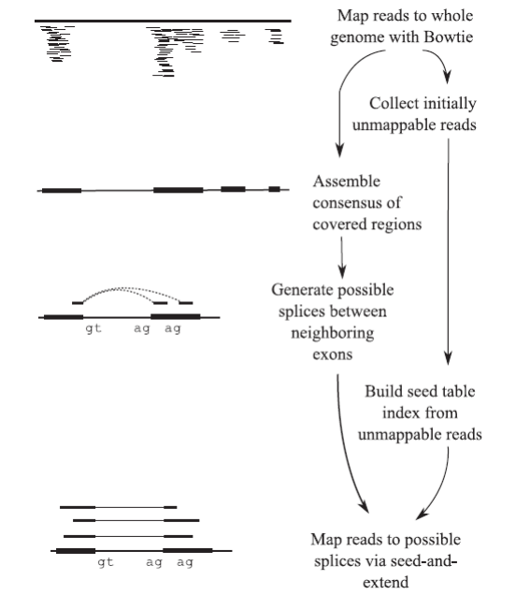
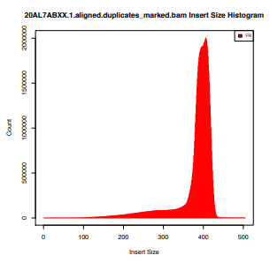
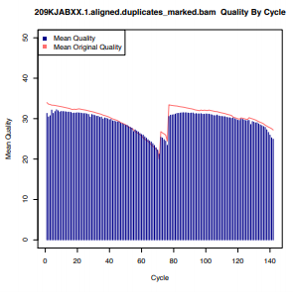
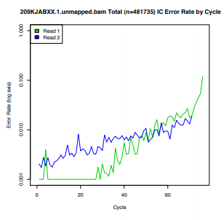
2.6 Alignment
Steps with TopHat
Unspliced reads are mapped to locate exons (with Bowtie)
Unmapped reads are then split and aligned independently to identify exon
Important to check the quality of mapping process (percentage of mapped reads)
Picard can be used for quality control of mapping
TopHat Pipeline

Slide 51
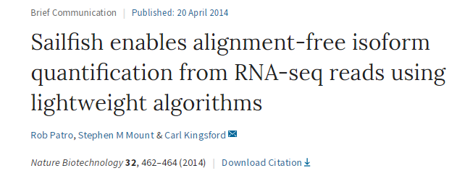
2.6 Alignment
Alignment-independent quantification for RNA-Seq
Alignment steps are computationally heavy and can be very time-consuming even with multi-threading.
In 2014, Sailfish method, demonstrated that it was not necessary to actually align each read to the genome in order to obtain accurate transcript each read.
https://cgatoxford.wordpress.com/2015/10/12/road-testing-kallisto/

Slide 52
2.6 Alignment
Alignment-independent quantification for RNA-Seq
Alignment steps are computationally heavy and can be very time-consuming even with multi-threading.
In 2014, Sailfish method, demonstrated that it was not necessary to actually align each read to the genome in order to obtain accurate transcript each read.
All you actually need to do is establish the most likely transcript for each read
shredding the transcriptome and reads into kmers (short overlapping sequences)
matching the transcriptome and read kmers (is a very fast and low memory usage)
https://cgatoxford.wordpress.com/2015/10/12/road-testing-kallisto/

Slide 53
2.6 Alignment
Alignment-independent quantification for RNA-Seq
Nowadays there exist various tools:
Salmon, Kallisto, Sailfish
PROS:
Extremely Fast & Lightweight (can quantify 20 million reads in five minutes on a laptop computer)
Easy to use

Slide 54
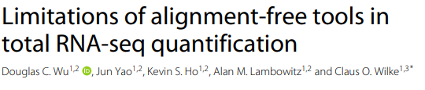
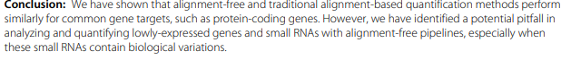
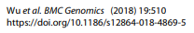
2.6 Alignment
Alignment-independent quantification for RNA-Seq
Nowadays there exist various tools:
Salmon, Kallisto, Sailfish
PROS:
Extremely Fast & Lightweight (can quantify 20 million reads in five minutes on a laptop computer)
Easy to use

Slide 55
Introduction to omics data analysis
An example of omics data analysis. RNA-seq
What is RNA-seq
Basic key concepts
Main challenges in RNA-seq
RNA-seq vs Microarrays
RNA-seq analysis pipeline(s)
Alignment
Transcript assembly
DEG Analysis
Vizualization

Slide 56
2.5 RNA-seq analysis pipeline(s)
Griffith, 2015 DOI: 10.1371/journal.pcbi.1004393

Slide 57
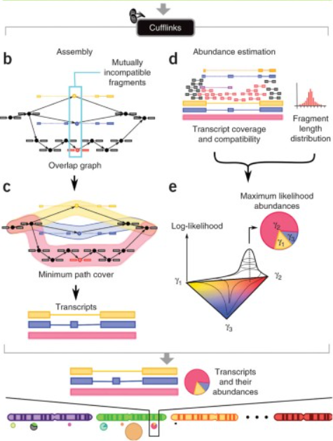
2.5 RNA-seq analysis pipeline(s)
TopHat alignment
https://www.nature.com/articles/nbt.1621

Slide 58
Introduction to omics data analysis
An example of omics data analysis. RNA-seq
What is RNA-seq
Basic key concepts
Main challenges in RNA-seq
RNA-seq vs Microarrays
RNA-seq analysis pipeline(s)
Alignment
Transcript assembly
DEG Analysis
Vizualization

Slide 59
2.5 RNA-seq analysis pipeline(s)
Griffith, 2015 DOI: 10.1371/journal.pcbi.1004393

Slide 60
2.5 RNA-seq analysis pipeline(s)
Count-based methods:
assign the reads to transcripts directly.
Abundance based methods: assign abundance of each transcript with a probabilistic model that makes use of info such as fragment length distribution etc. Many software tools want raw counts for input because they do their own normalization.
Griffith, 2015 DOI: 10.1371/journal.pcbi.1004393

Slide 61
2.5 RNA-seq analysis pipeline(s)
Griffith, 2015 DOI: 10.1371/journal.pcbi.1004393
Differential expression:
taking the normalized read count data and performing statistical analysis to discover quantitative changes in expression levels between experimental groups.
Alternative expression: analysis of RNA-seq data to catalog transcripts and assess alternative expression of known and predicted mRNA isoforms in cells and tissues

Slide 62
Introduction to omics data analysis
An example of omics data analysis. RNA-seq
What is RNA-seq
Basic key concepts
Main challenges in RNA-seq
RNA-seq vs Microarrays
RNA-seq analysis pipeline(s)
Alignment
Transcript assembly
DEG Analysis
Vizualization

Slide 63
2.5 RNA-seq analysis pipeline(s)
Griffith, 2015 DOI: 10.1371/journal.pcbi.1004393

Slide 64
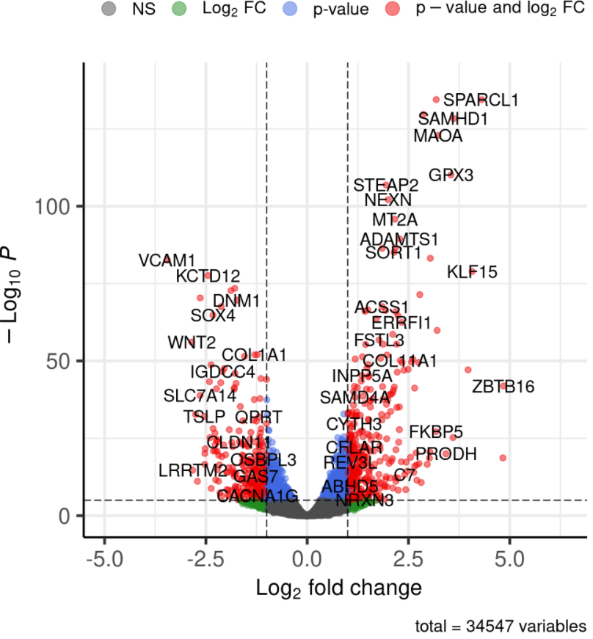
2.10 Vizualization
Volcano plots
https://www.bioconductor.org/packages/release/bioc/vignettes/EnhancedVolcano/inst/doc/EnhancedVolcano.html
Notes:
In statistics, a volcano plot is a type of scatter-plot that is used to quickly identify changes in large data sets composed of replicate data.^{[1]} It plots significance versus fold-change on the y and x axes, respectively. These plots are increasingly common in omic experiments such as genomics, proteomics, and metabolomics where one often has a list of many thousands of replicate data points between two conditions and one wishes to quickly identify the most meaningful changes. A volcano plot combines a measure of statistical significance from a statistical test (e.g., a p value from an ANOVA model) with the magnitude of the change, enabling quick visual identification of those data-points (genes, etc.) that display large magnitude changes that are also statistically significant.

Slide 65
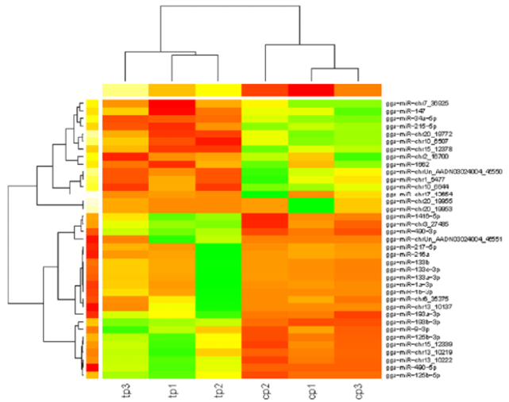
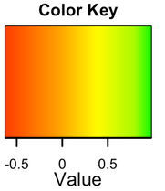
2.10 Vizualization
Heatmap
https://bmcgenomics.biomedcentral.com/articles/10.1186/s12864-016-3413-8

Slide 66
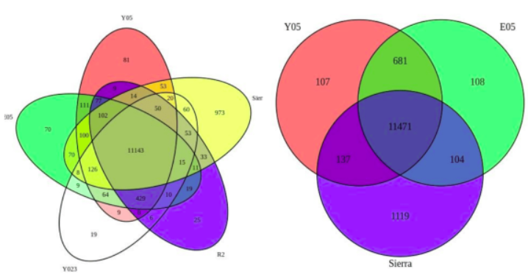
2.10 Vizualization
Venn diagrams
https://www.r-bloggers.com/2020/08/comparing-data-sets-with-venn-diagrams/

Slide 67
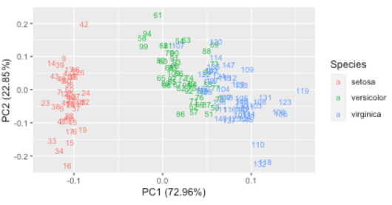
2.10 Vizualization
PCA
https://cran.r-project.org/web/packages/ggfortify/vignettes/plot_pca.html
Notes:
En estadística, el análisis de componentes principales (en español ACP, en inglés, PCA) es una técnica utilizada para describir un conjunto de datos en términos de nuevas variables («componentes») no correlacionadas. Los componentes se ordenan por la cantidad de varianza original que describen, por lo que la técnica es útil para reducir la dimensionalidad de un conjunto de datos.
Técnicamente, el ACP busca la proyección según la cual los datos queden mejor representados en términos de mínimos cuadrados. Esta convierte un conjunto de observaciones de variables posiblemente correlacionadas en un conjunto de valores de variables sin correlación lineal llamadas componentes principales.

Slide 68
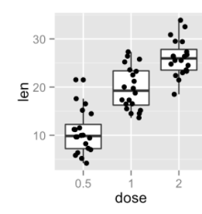
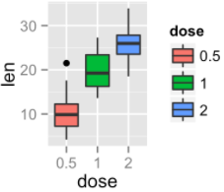
2.10 Vizualization
Boxplot
http://www.sthda.com/english/wiki/ggplot2-box-plot-quick-start-guide-r-software-and-data-visualization
Notes:
Un diagrama de caja (también, diagrama de caja y bigotes o box plot) es un método estandarizado para representar gráficamente una serie de datos numéricos a través de sus cuartiles. De esta manera, se muestran a simple vista la mediana y los cuartiles de los datos,¹​ y también pueden representarse sus valores atípicos.

Slide 69
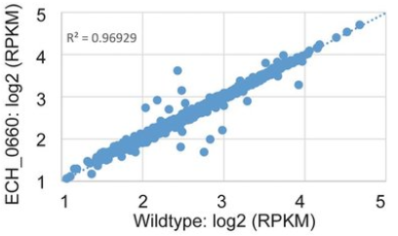
2.10 Vizualization
Scatter plot
https://www.nature.com/articles/s41598-018-24471-3

Slide 70
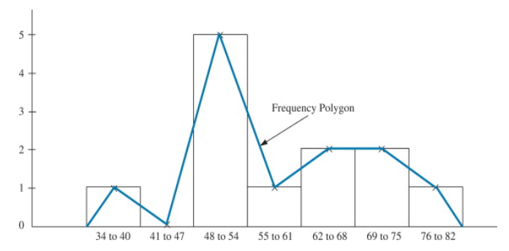
2.10 Vizualization
Frequency plots
https://www.sciencedirect.com/topics/mathematics/frequency-polygon
Notes:
A frequency plot is a graphical data analysis technique for summarizing the distributional information of a variable. The response variable is divided into equal sized intervals (or bins). The number of occurrences of the response variable is calculated for each bin

Slide 71
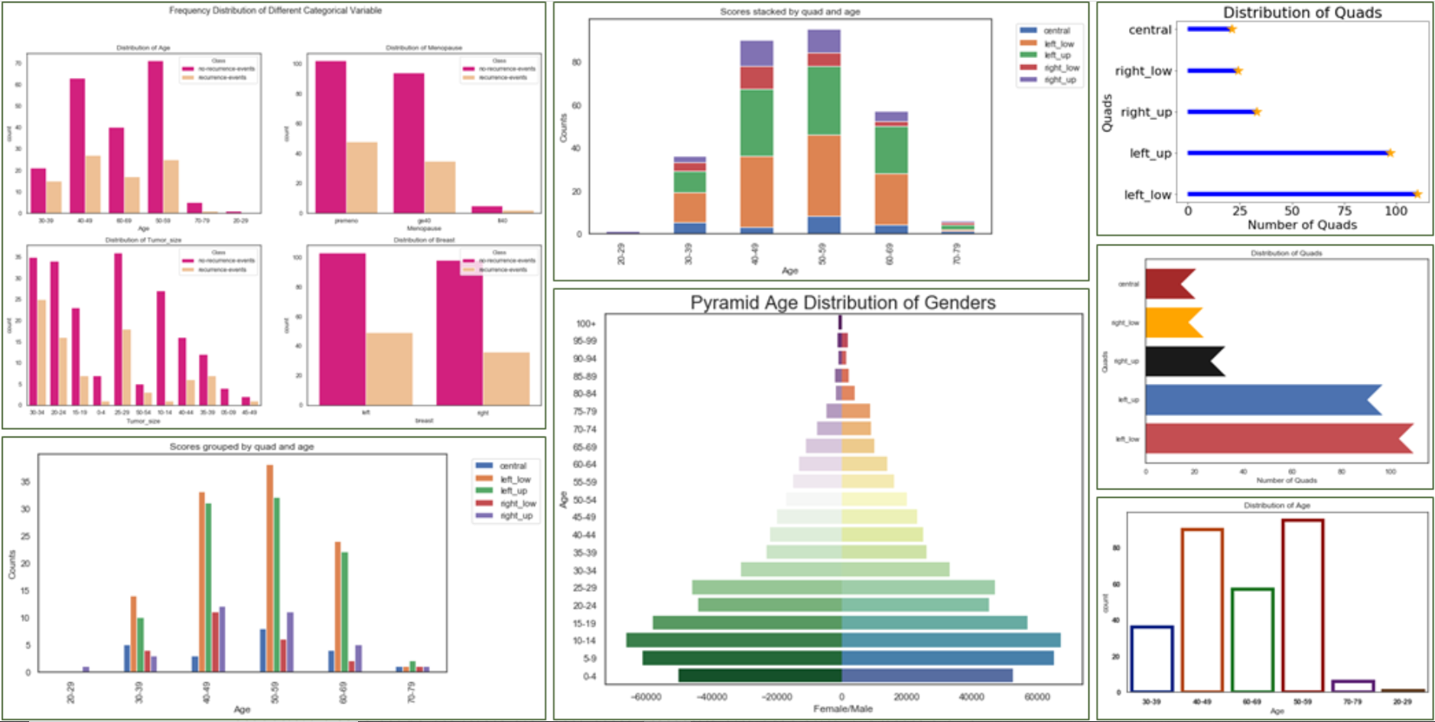
2.10 Vizualization
Barplots
https://towardsdatascience.com/different-bar-charts-in-python-6d984b9c6b17

Slide 72
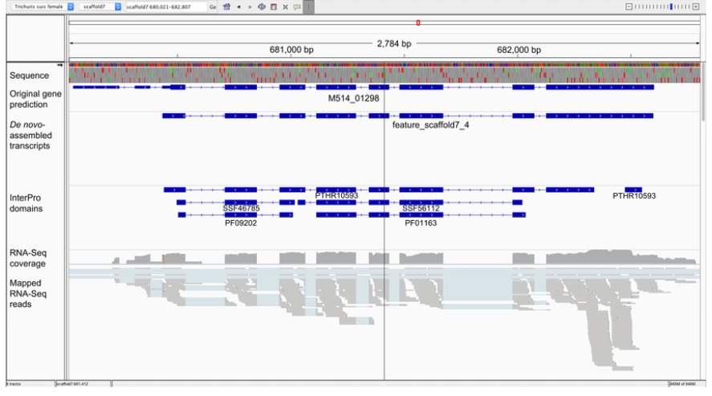
2.10 Vizualization
Viewers
UCSC genome browser, IGV...
https://pubmed.ncbi.nlm.nih.gov/29717207/

Slide 73
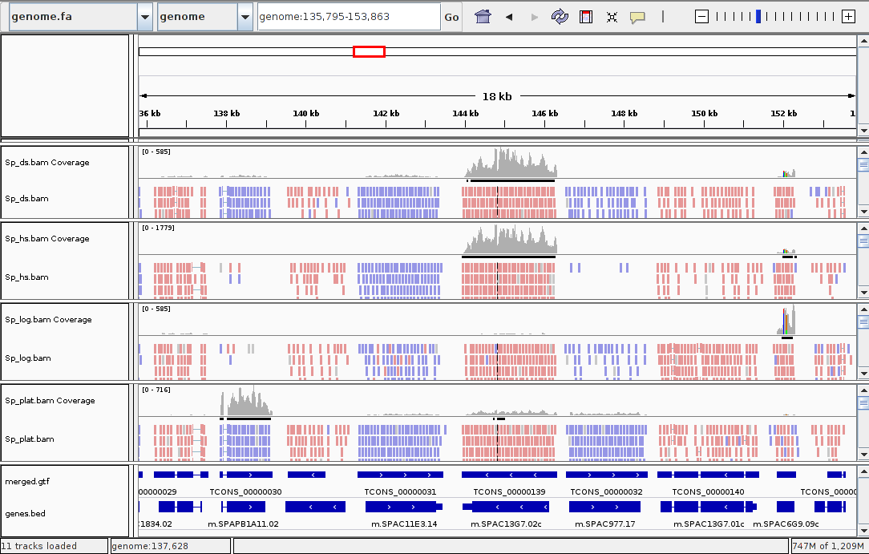
2.10 Vizualization
RNA-seq paired and stranded reads
https://bioinformatics.stackexchange.com/questions/2466/interpreting-intergrative-genomic-viewer-igv

Slide 74
2.10 Vizualization
RNA-seq paired and stranded reads
https://bioinformatics.stackexchange.com/questions/2466/interpreting-intergrative-genomic-viewer-igv

Slide 75
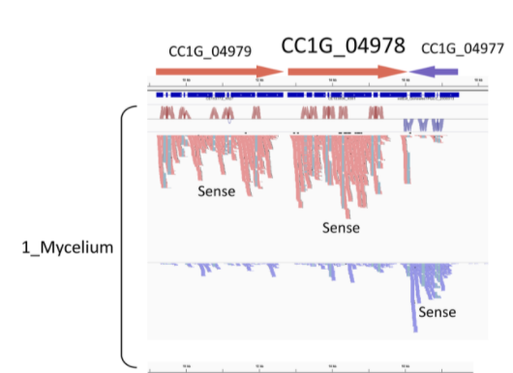
2.10 Vizualization
RNA-seq paired and stranded reads
https://journals.plos.org/plosone/article/figure?id=10.1371/journal.pone.0141586.g008

Slide 76
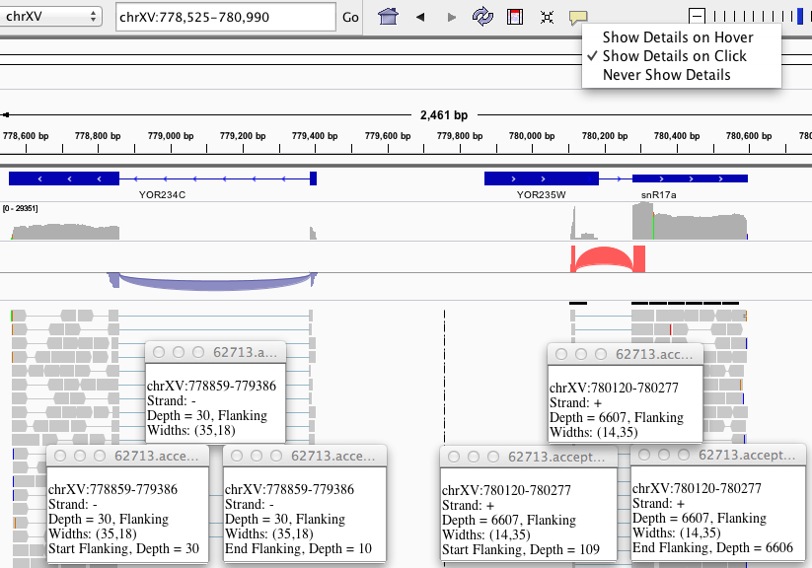
2.10 Vizualization
Junctions detected with TopHat
https://software.broadinstitute.org/software/igv/splice_junctions

Slide 77
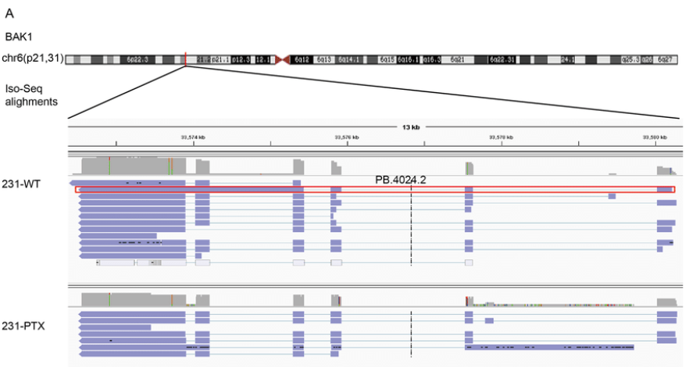
2.10 Vizualization
Iso-Seq RNA-seq (TGS)
https://www.nature.com/articles/s41598-019-42184-z

